Slide 1
Predicting IVR call intent

Slide 2
Contents
Introduction
Executive Summary
Scope and Data
Data Summary
Data and its Variables (Features)
Modeling approach
Model performance metrics
Data Preparation
Analysis & Modeling
Model variables (features selected by XGBM Classifier)
Checking for Common Features (Top-10)
Model Validation
Model Validation – Comparison of Models performance
Validation of Model– Performance Metrics Of The Selected Model
Evaluation of Model – Performance Metrics Of The Selected Model
Gains chart
Model Observations
Business Suggestions for further enhancements
Data Quality Issues
Acknowledgement
2

Slide 3
Introduction
XYZ insurance is the India's leading life insurance company established in founded in 2000. The company is headquartered at New Delhi .
XYZ insurance company ltd offers comprehensive life insurance and retirement solutions for the long-term savings and the protection to more than 30 lakh customers.
While customer-service is key of company’s success ,IVR or Interactive Voice Response is an essential tool for helping customer in finding the information quickly and improve the customer experience
IVR, uses touch-tone or speech recognition technology to identify and route callers to the most qualified agents, driving greater efficiency of the customer satisfaction.
Though IVR allows customers to save time, customers lose patience when they are forced to listen to long m menu menu options. Fortunately, a great benefit of IVR is allowing customers to skip the options they don’t need, which saves time and bandwidth.
The business problem is to identify and recommend the top 3 intents specific to each of the customers.
Company Introduction
Business
context
Business Problem
3

Slide 4
Executive Summary
Background: XYZ Insurance planning to implement an IVR (Interactive Voice Response) system that identifies a customer based on previous customer interactions. Customer intent is predicted for an ongoing interaction and personalized services are proactively offered to the customer. A self-optimizing algorithm improves intent prediction, customer identity, and customer willingness to engage and use IVR. This project is to generate customised short IVR with 3 expected intents to serve customers.
Purpose: Prediction of Top-3 Intents for IVR based on prior previous customer interactions.
Data: Historical call data collected between January 2018 and March 2019 related to 13 intents from various sources was used to predict Top-3 Intents for IVR.
Modelling Approach: To develop a prediction module which predicts the top 3 intents using machine learning algorithms.
Key steps involved are:
To develop a predicted score/probability for each intents independently.
The intents with top 3 score/probabilities were considered for new IVR.
To validated the model to ensure consistent results on both train and test samples.
Model Outcome : Overall model performance is consistent on both train and test samples with more than 70% Recall (Match rate). This implies that 7 of 10 customers the predicted options will be accurate in real time. The Match rate is higher for top 3 intents (ranging from >80% to 99%).
4

Slide 5
Scope and Data
Scope :
Scope of the project includes the data collected from various touch points – UNO, IVR, My money ,Mega soft , SCOPP, My-flow-POS, Help Line.
This data was interpreted further to predict the top-3 intents for the customer when customer reaches out XYZ insurance through IVR system.
Data summary:
Historical IVR calls : Call details between January 2018 and March 2019 related to 13 intents from various sources.
Number of IVR calls : 51739
Features in dataset :
Intent touch point/ source system details
Customer details
Policy details
180 (including all Indicator variables)
Approximately 40 categorical variables (details in Slide 7)
5

Slide 6
The data can be categorised into 3 details depending on the information as shown :
IVR Call Details
Helpline Details
SCOPP- Email ticket is logged with Intent
My Money System Customer Call details
Mega soft -Hardcopy Material package dispatched
UNO-Email send by Customer details
IVR -Number of times that Policy ID served through IVR for Intent
Any walk-in to XYZ Branch
Insurance Policy details
Policy channel
Plan family
Plan category
Electronic Clearing Service
policy coverage term
policy premium term
new policy
Customer details
Education
Occupation
Income
Individual Net worth
Single / Multiple Policy Holder
Clean_Intent is the target variable , which is to be predicted specific to customers .
13 distinct values
Depending on the call details of IVR , Intent has been categorised and this has been converted to labels(0-12)
The business problem is to identify and predict top 3 intents when the customer calls the IVR based on the historical data.
Data Summary

Slide 7
Data and its Variables (Features)
VARIABLE | DESCRIPTION
mapped_pol_id | Customer_id
CLEAN_INTENT | Helpline System- Keeps Track of Inbound calls to Max and Intent for which Call has been made
POS_COUNT | POS System- Any walkin to Max Branch is recorded in this system
POS_VINTAGE_SCORE
POS_SYS_TOUCH_PT
REN_COUNT | Renewal System - Keeps the Record of Outbound Calls to client related to Renewal of premium
REN_VINTAGE_SCORE
REN_SYS_TOUCH_PT
DELIVERY_STATUS
UNO_CS_COMM_COUNT | UNO-CS Communication System stores the journey/ Status of ticket generated in helpline.i.e Any change in the ticket like Closure, Escalted is stored in this system
COMM_VINTAGE_SCORE
UNO_CS_COMM_SYS
SCP_SMS | Dummy Variable for SCOPP-SMS System ( Value in these columns is number of times SMS is sent in last 15 days)
MON_CLEARANCE_COUNT | My Money System - In this Transaction related to payment is recorded e.g. cheque cleared , cheeque bounced etc.
IVR | Dummy Variables/ Tranpose - Number of times that PolicY ID been served through IVR for particular Intent
UNO | Email send by Customer to Max Is tracked in this system
MEGA | Megasoft - Hardcopy Material package dispatch details are recorded in this System
SCP_EML | SCOPP-Email System- In this Inbound Email ticket is logged with Intent
HELP_LINE | Ticket is logged when Customer Call to Max Helpline with Specific Intent
DUE_DATE_SYS | Paid Status
DUE_VINTAGE_SCORE
DUE_STS_SYS
ind_surr | If Policy is already surrender in past.
new_policy | For a policy issued in last 15 days value = 1
Lock_in_ind | for Certain ULIP plans customer policy is atleast lock-in for a certain period
POL_PPT | policy premium term
POL_RIDER_COUNT | Extra Riders count
POL_COV_TERM | policy coverage term
ECS_FLAG_No | ECS Flag - Electronic Clearing Service i.e. funds automatically deducted from account
ECS_FLAG_Yes
POLICY_CHNL | Policy channel
CLI_OCCUPATION_CAT | Client Occupation ( Categorical Variable )
CLI_EDUCATION_CAT | Education Categories ( Grad & above , illiterate, high school etc.)
CLI_HNI_IND | High Networth Individual
PLAN_FAMILY | Plan Family ( Categorical Variable )
PLAN_CAT | Plan Category
PLAN_TYPE | Plan Type Categorical Variable
CLI_SNGL_MLTPL_PLCYHLDR_FLG | Flag for Single and Multiple policy holder
INCOME_BUK | Income Buckets / Category

Slide 8
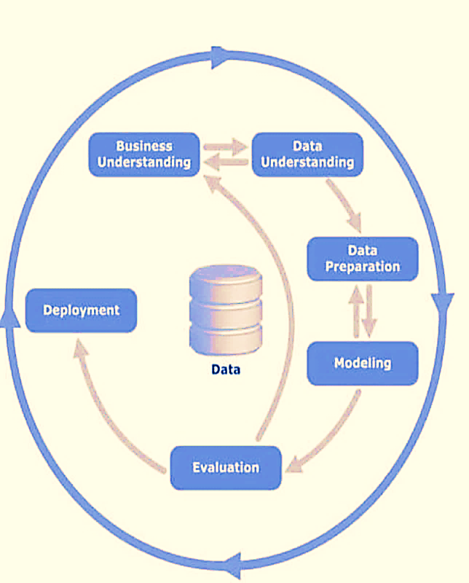
Modelling approach
Data Collection – All IVR call details between January 2018 and March 2019
Intent of the call
Policy details
Client details
IVR touch points from which the data has been gathered.
Data Preparation
Importing data from raw csv files
Random sampling – Data was sampled into trained (80%) and test (20%) sample.
The data is sampled using Random stratified sampling
Feature selection
Analysis and Modelling
Fitting classifier over train sample and to predict score/probability for all intents.
The top 3 intents among others specific to customer by score/probability were considered for New IVR.
Validate the model performance to ensure consistent results on both train and test samples.

Slide 9
Model performance metrics
Model performance metrics-
Assess the proposed model performance for its stability , strength and accuracy on the test sample.
Precision
Precision is the ratio of correctly predicted Intents to the total predicted positive intents
Recall
Recall is the ratio of correctly predicted intents to the all observations in actual class .
F1-score
F1 Score is the weighted average of Precision and Recall. This score takes both false positives and false negatives into account.
Accuracy
Accuracy is the ratio of correctly predicted intents to the all observations.
Discrimination Metrics
Area under ROC, Confusion matrix
It describes the discrimination power to identify the intent as different from other intents
Conclusion – Constructive solution to identify the top 3 intents for each of the specific customers.

Slide 10
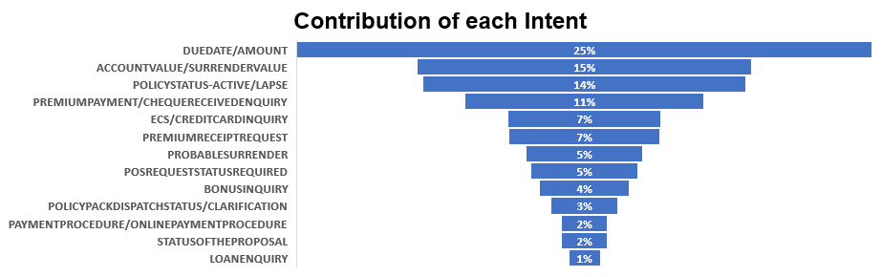
Data Preparation - Exploring Intents
Observation :
The major intents covers most usual concerns like duedate , amount to be paid , account value ,active/lapse , payment mode. Around 28,000 call cover these major intents.
Top-3 intents contribute 54% of call volumes .
Duedate/Amount has highest contribution within Intents followed by account value/surrender value and policystatus-active/lapse
On going in the decreasing trend the intents paymentprocedure/onlinepaymentprocedure , statusoftheproposal, loanenquiry contribute 5 % of the total data.

Slide 11
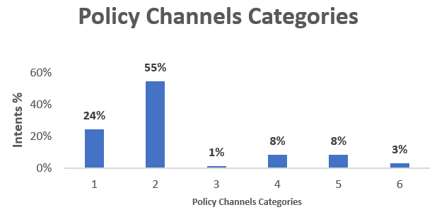
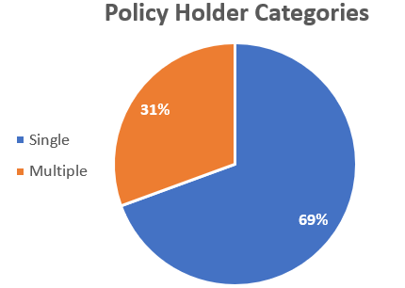
Data Preparation–Exploring Insurance Policy Details
Observations :
The pie charts helps us in understanding the relation ship between the following features and target variable :
Policy Channel :The 1st pie charts depicts the relationship between number of intents registered per policy channel. The policy channel-2 is having higher number of intents while policy channel-3 has lowest number of intents registered .
Type of Policy Holders: The IVR calls received by single policy holders are more when compared with multiple policy holders. The type of policy holders shows the significant difference in the calls received.

Slide 12
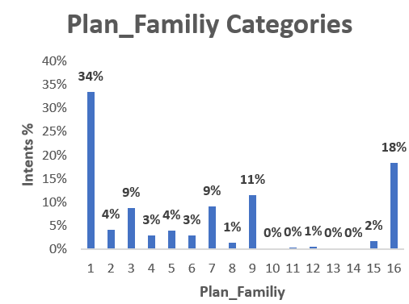
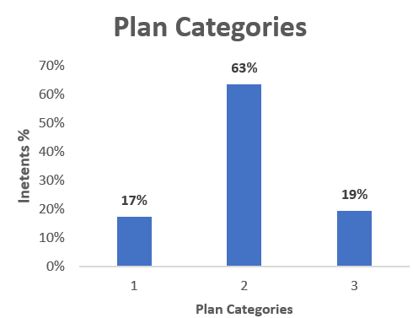
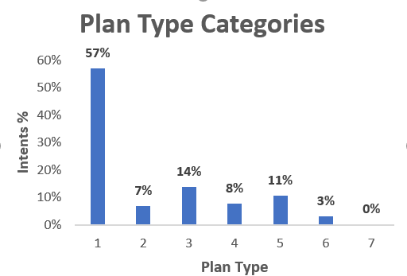
Data Preparation – Exploring Insurance Policy Plan Details
Observations :
The pie charts helps us in understanding the relation ship between the following features and target variable, Intents :
Family Plan Categories: The family plan category -1 is having highest contribution of 34%. Family plan categories 9& 16 contribute around 29% .
Plan Category : Major contribution is from plan type-2 with 63% of the intents and plan type-1 is having least contribution of 17%
Plan Type Categories: Plan Type -1 contributes of 57% of the intents and other two plan types- 3 & 5 contributes 25%

Slide 13
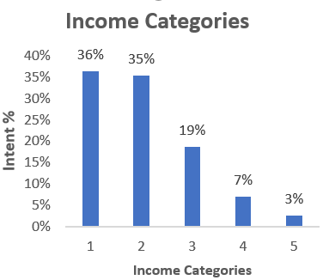
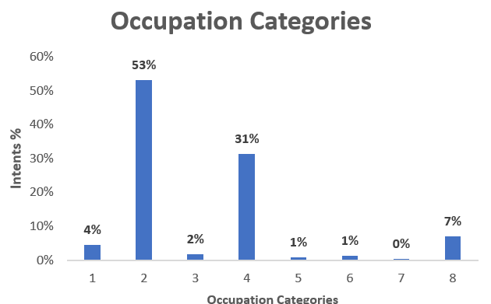
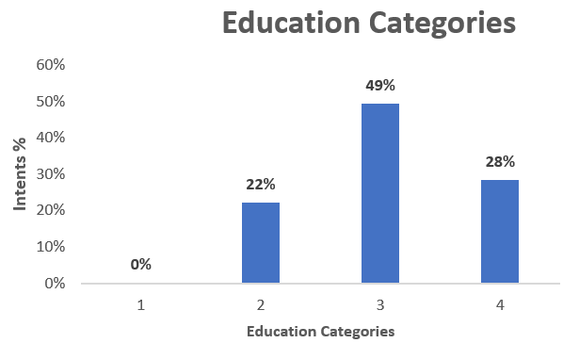
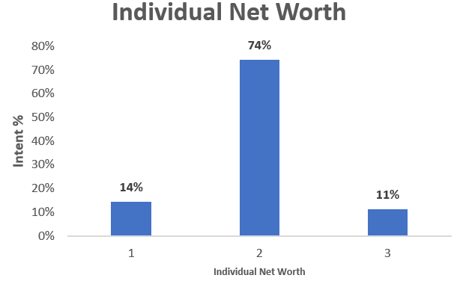
Data Preparation – Exploring Customer Details
The pie-charts helps in understanding the customer profiling against intents in the following categories :
Education : The education category -3 has highest contribution of 49% and category-1 is having the lowest of 0%
Occupation : The occupation category -2 has highest contribution in the IVR intents while occupation bucket 3,5,6 has lowest contribution of 1%.
Income : The income bucket -1,2 has major contribution in the intents of IVR call of around 35% each, while income bucket-5 has lowest contribution of 3%.
Net worth : Higher number of intents registered in category 2 .

Slide 14
Clubbing of Sparse variables:
Sparse variable(<1% data present in 95th percentile) are clubbed into one column in their respective categoric-wise.
Impute Missing values:
Filled missing values of POL_PPT with mode value of the column .
Dropping of datetime variables:
Keeping the vintage score column for the respective date fields
Random sampling – split all IVR data into train and test samples.
Train sample = 80% of randomly chosen IVR call information.
Test sample = 20% of remaining IVR call information.
The data is sampled using Random stratified sampling to obtain a sample population that best represents the entire population and make homogeneous groups based on target variable IVR Intent.
Data Preparation – Preparing Train & Test samples

Slide 15
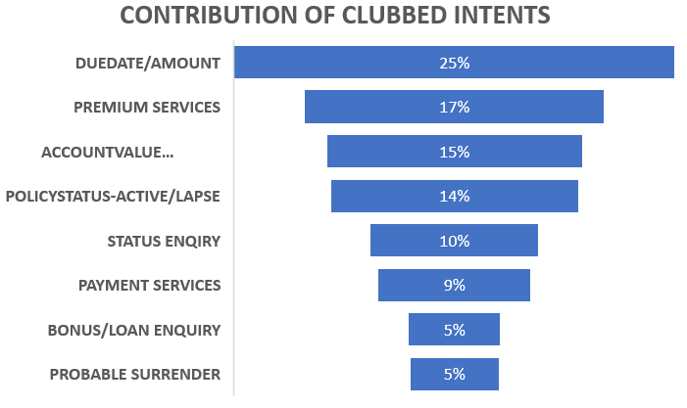
Combining Intents (Target variable)
13 distinct Intents were combined into 8 distinct intents which are having similar business category sense.
Clubbing is done on the basics of services offered by the XYZ Insurance.
By clubbing we need not to drop the data and it will have benefits in pattern finding also.
Intents | # of Calls | Clubbed Intents | # 0f calls
DUEDATE/AMOUNT | 13055 | Duedate/Amount | 13055
ACCOUNTVALUE/SURRENDERVALUE | 7574 | Accountvalue/Surrendervalue | 7574
PROBABLE SURRENDER | 2643 | Probable Surrender | 2643
POLICYSTATUS-ACTIVE/LAPSE | 7338 | Policystatus-active/Lapse | 7338
PREMIUMPAYMENT/CHEQUERECEIVEDENQUIRY | 5434 | Premium Services | 8871
PREMUM RECEIPT REQUEST | 3437
POS REQUEST STATUS REQUIRED | 2447 | Status Enquiry | 4989
STATUSOFTHEPROPOSAL | 1039
POLICYPACKDISPATCHSTATUS/CLARIFICATION | 1503
ECS/CREDITCARD INQUIRY | 3486 | Payment Services | 4536
PAYMENTPROCEDURE/ONLINEPAYMENTPROCEDURE | 1050
BONUSINQUIRY | 2019 | Bonus/Loan Enquiry | 2733
LOANENQUIRY | 714
Data Preparation – Target Variable

Slide 16
Transformation of Intents (Target variable) to numeric labels :
8 distinct IVR intents are encoded to numerical labels ranging from (0-7)
Feature Selection:
Used different feature selection methods –
Weight of Evidence and Information value
Gradient Boost classifier , Extra Tree Classifier ,
Extra Gradient Boost Classifier
Random Forest
Select K-best (Chi-Square)
P-Value ( with confidence level of 95%)
The features were ranked by their feature importance using above methods.
Top 50 features were picked from each method.
Analysis & Modelling –Predictor & Feature selection

Slide 17
Analysis & Modelling – Techniques Adopted
Linear models:
Logistic Regression:
Logistic Regression is used to solve the classification problem of identifying the top 3 Intents for the customer who is reaching out through IVR based on his historical data.
It provides the flexibility to fit various distributions like Binomial, Gaussian, Poisson and so on.
It helps in understanding the relationship between response variable and the independent variables.
Ensemble Classifiers:
Random forest Tree Classifier
Random forest builds multiple decision trees on bootstrapped samples and merges them together to get a more accuracy .
Each time a split in a tree is considered , it chooses random subset of predictors as split candidates, rather than choosing the optimal predictors from the full set of predictors .
Random Forest is a flexible, easy to use machine learning algorithm that produces, even without hyper-parameter tuning, a great result most of the time.

Slide 18
Analysis & Modelling – Techniques Adopted
Ensemble Boosting Classifiers:
Gradient boosting Classifier
This machine learning technique leverages the patterns in residuals and strengthen a model with weak predictions and make it better.
Once we reach a stage that residuals don’t have any pattern that could be modeled , we can stop modelling the residuals.
It build trees one at a time, where each new tree helps to correct errors made by previously trained tree thus resulting in a stronger learning model that predicts Intents better.
AdaBoost :
Adaboost is short name for Adaptive Boosting . AdaBoost was designed in such a way that at every step the sample distribution was adapted to put more weight on misclassified intents and less weight on correctly classified intents.
The final prediction is a weighted average of all the weak learners, where more weight is placed on stronger learners.

Slide 19
Analysis & Modelling – Techniques Adopted
LGBM Classifier :
Light GBM grows tree vertically while other algorithm grows trees horizontally meaning that Light GBM grows tree leaf-wise while other algorithm grows level-wise. It will choose the leaf with max delta loss to grow. When growing the same leaf, Leaf-wise algorithm can reduce more loss than a level-wise algorithm.
This ensemble model turned out to be useful.
XGBM Classifier :
It implements machine learning algorithms under the Gradient Boosting framework.
It is a optimized gradient boosting algorithm through parallel processing (also known as GBDT, GBM) , tree-pruning, handling missing data and regularization to avoid overfitting that solve many data science problems in a fast and accurate way.
XGBoost and Gradient Boosting Machines (GBMs) are both ensemble tree methods that apply the principle of boosting weak learners (CARTs generally) using the gradient descent architecture. However, XGBoost improves upon the base GBM framework through systems optimization and algorithmic enhancements.

Slide 20
Analysis & Modelling - Performance Metrics used
Performance Metrics used for Prediction of Top-3 Intents :
Accuracy :Multi-class accuracy is defined as the number of correct predictions over total predictions in the data.
The accuracy for top3 intents is calculated such that if the actual intent matches with one of top 3 classes predicted by the model as correct predictions.
Area under ROC(AUC) : This tells how well a classifier can separate the selected intent from the other intents .
This is calculated with any of the top 3 predicted classes that matched with actual intent as ‘1’ and the rest as zero .
Confusion Matrix : Confusion Matrix is a performance measurement for a classification algorithm where output can be with more classes.
For any of the top-3 classes matching with actual intent ,the prediction is considered as ‘true’ and rest as false
Classification Report :
A macro-average will compute the metric independently for each class and then take the average (hence treating all classes equally), whereas a micro-average will aggregate the contributions of all classes to compute the average metric.
In a multi-class classification setup, macro-average is preferable if you suspect there might be class imbalance
Precision : It is the fraction of relevant instances among the retrieved instances
Recall : It is the fraction of relevant instances that have been retrieved over the total amount of relevant instances.
F1 Score : It is the harmonic average of the precision and recall

Slide 21
Analysis & Modelling –Based On Various Feature Selection Techniques
Feature Selection | Accuracy-Predicting TOP-3 Intents(Train Data)
 | Logistic Regression | Random Forest | XGBM Classifier | LGBM Classifier | Ada Boosting | Gradient Boosting
WOE & IV | 68.8 | 67.4 | 69.6 | 73.0 | 68.8 | 69.7
ExtraTree Classifier | 70.8 | 67.8 | 71.8 | 74.8 | 70.4 | 71.8
Gradient Boosting Classifier | 70.8 | 67.5 | 71.7 | 73.1 | 70.2 | 72.1
XGBClassifier | 71.3 | 69.1 | 72.3 | 77.1 | 71.3 | 73.3
Random Forest Classifier | 70.6 | 67.8 | 71.2 | 75.6 | 69.8 | 71.4
Select K best (Chi-square) | 70.8 | 68.4 | 71.7 | 73.0 | 70.4 | 72.0
P-Value (0.05) | 69.2 | 67.6 | 70.4 | 72.8 | 69.0 | 70.4
Model Selection :
With feature selection of XGBClassifier , Light Gradient Boost Classifier is at par with other models. So the model is selected for further analysis.

Slide 22
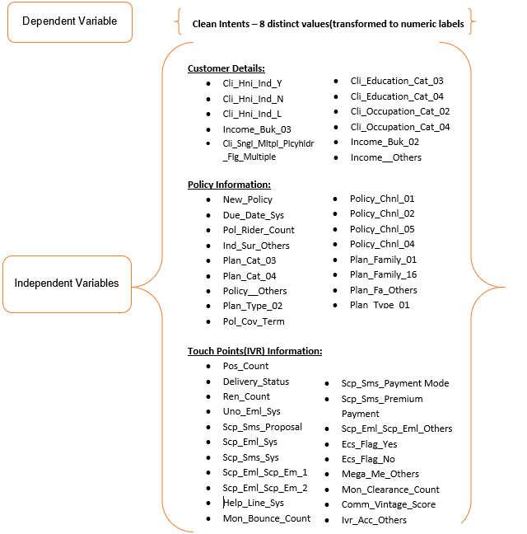
Model variables (features selected by XGBM Classifier)

Slide 23
Model Validation –Performance On Train Sample
With features selected from XGBM classifier, the performance on train sample with various hyperparameter tuned models is as tabulated below:
TRAIN DATA | Logistic Regression | Random Forest | XGBM Classifier | LGBM Classifier | Ada Boosting | Gradient Boosting
Accuracy (Predicting Top-3 Intents) | 71.3 | 69.1 | 72.3 | 77.1 | 71.3 | 73.3
Area under ROC | 77.5 | 73.3 | 78.1 | 82.3 | 77.6 | 79
Precision | 0.80 | 0.60 | 0.81 | 0.82 | 0.80 | 0.80
Recall | 0.59 | 0.51 | 0.60 | 0.68 | 0.59 | 0.62
F1-Score | 0.62 | 0.51 | 0.63 | 0.71 | 0.62 | 0.65

Slide 24
Model Validation –Performance On Test Sample
With features selected from XGBM classifier ,the performance on test sample with various hyperparameter tuned models is as tabulated below:
TEST DATA | Logistic Regression | Random Forest | XGBM Classifier | LGBM Classifier | Ada Boosting | Gradient Boosting
Accuracy (Predicting Top-3 Intents) | 71.0 | 68.7 | 71.6 | 72.2 | 70.1 | 72.1
Area under ROC | 77.4 | 73.1 | 77.4 | 78.5 | 76.9 | 78
Precision | 0.79 | 0.59 | 0.81 | 0.78 | 0.80 | 0.79
Recall | 0.59 | 0.51 | 0.59 | 0.61 | 0.58 | 0.60
F1-Score | 0.62 | 0.50 | 0.62 | 0.64 | 0.61 | 0.63

Slide 25
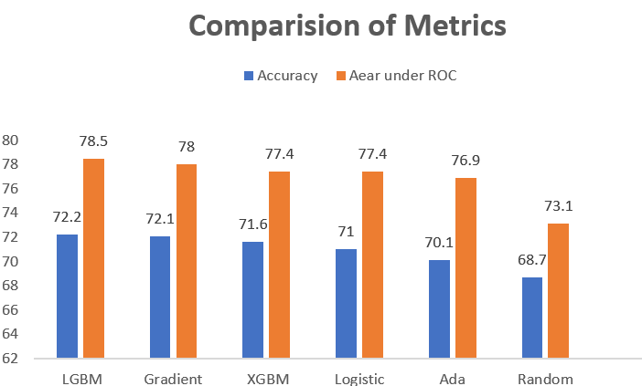
Model Validation – Comparison of Models performance
We have predicted Top 3 intents for each policy ,and have been able to achieve accuracy of 72.2% with Light Gradient Boost Classifier(XGBM feature selection technique)
Model using Light Gradient Boost Classifier(LBGM) vs Other models
The performance of the model using Light Gradient Boost Classifier is at par with other models on train sample.
The performance on test sample is consistent and at par with the respective model’s performance on train sample.
This concludes there is no overfit of all the model on the train sample.
Acceptable model performance for Light Gradient Boost Classifier
The Area under ROC (78.5%) and Accuracy index (72.2%) on test samples.
The performance of the model has not improved even after including all Independent Variables in the train sample. This concludes the unexplained Dependent Variable is due lack of appropriate Independent Variables in the data and not necessarily because of the error in the model fit.

Slide 26
Validation of Model– Performance Metrics Of The Selected Model
Prediction of Top-3 Intents by LGBM(XGBM feature selection technique) :
The selected Model on the test data has showed an accuracy of 72.2%
Based on the XGBM features selected , we further deep dive in to check for different categories of clients based on their details the pattern of top 3 intents prediction.
CLI_OCCUPATION_CAT_02 | CLI_HNI_IND_N | CLI_EDUCATION_CAT_04 | CLI_HNI_IND_Y | CLI_SNGL_MLTPL_PLCYHLDR_FLG_SINGLE | CLI_EDUCATION_CAT_02 | CLI_SNGL_MLTPL_PLCYHLDR_FLG_MULTIPLE | CLEAN_INTENT | Top-1 | Top-2 | Top-3 | Intent Predicted by Model | Matched
1 | 0 | 0 | 1 | 0 | 0 | 1 | 0 | 3 | 2 | 0 | 0 | YES
1 | 1 | 0 | 0 | 1 | 0 | 0 | 2 | 2 | 5 | 0 | 2 | YES
0 | 1 | 1 | 0 | 1 | 0 | 0 | 7 | 7 | 1 | 2 | 7 | YES
0 | 0 | 1 | 1 | 0 | 0 | 1 | 1 | 1 | 7 | 4 | 1 | YES
1 | 1 | 0 | 0 | 0 | 1 | 1 | 6 | 4 | 0 | 7 | 0 | YES
0 | 1 | 0 | 0 | 1 | 0 | 0 | 3 | 3 | 2 | 5 | 3 | YES
1 | 1 | 1 | 0 | 0 | 0 | 1 | 4 | 4 | 7 | 5 | 4 | YES
1 | 1 | 0 | 0 | 1 | 0 | 0 | 6 | 2 | 0 | 5 | 2 | NO
0 | 1 | 1 | 0 | 0 | 1 | 1 | 1 | 0 | 2 | 4 | 0 | NO
1 | 1 | 0 | 0 | 0 | 0 | 1 | 4 | 2 | 3 | 5 | 2 | NO

Slide 27
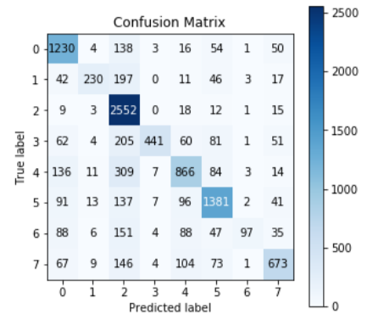
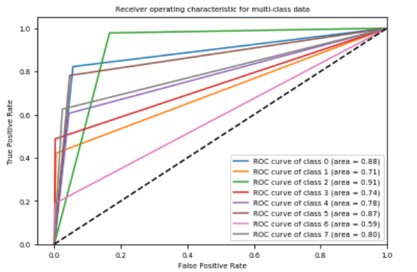
Validation of Model– Performance Metrics Of The Selected Model
Performance metrics of LGBM(XGBM feature selection technique) :
ROC for Intents
Confusion matrix for Intents
Classification Report
Intent | Precision | Recall | F1-Score
0 | 0.71 | 0.82 | 0.76
1 | 0.82 | 0.42 | 0.56
2 | 0.67 | 0.98 | 0.79
3 | 0.95 | 0.49 | 0.64
4 | 0.69 | 0.61 | 0.64
5 | 0.78 | 0.78 | 0.78
6 | 0.89 | 0.19 | 0.43
7 | 0.75 | 0.62 | 0.68
Weighted Avg | 0.75 | 0.72 | 0.7

Slide 28
Champion model
Logistic regression
Challenger Model
LGBM Classifier
Common features
PLAN_CAT_04
new_policy
POLICY_CHNL_04
CLI_SNGL_MLTPL_PLCYHLDR_FLG_MULTIPLE
UNO_EML_SYS
ECS_FLAG_No
SCP_EML_SYS
PLAN_CAT_02
MON_CLEARANCE_COUNT
ECS_FLAG_Yes
POL_COV_TERM
COMM_VINTAGE_SCORE
SCP_SMS_PAYMENT MODE
REN_COUNT
DELIVERY_STATUS
MON_BOUNCE_COUNT
new_policy
MON_CLEARANCE_COUNT
SCP_EML_SCP_EM_1
HELP_LINE_SYS
new_policy
MON_CLEARANCE_COUNT
Checking for Common Features (Top-10 )

Slide 29
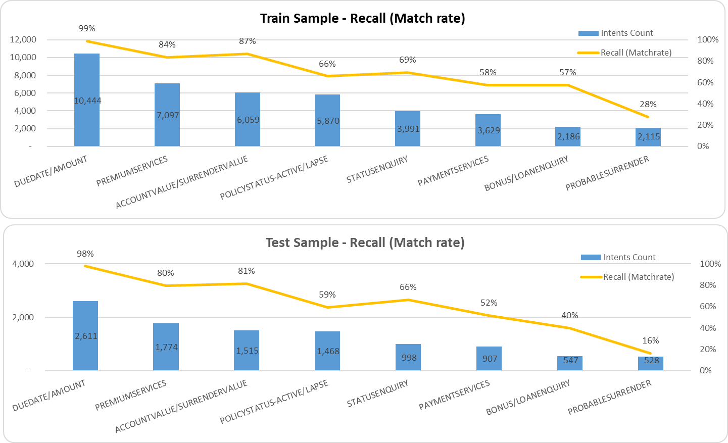
Evaluation of Model – Performance Metrics Of The Selected Model
Overall Model Performance (LGBM ):
Overall model performance is consistent on both train and test samples with more than 70% Recall. This implies that 7 of 10 customers the predicted options will be accurate in real time.
The model is quite good for the following IVR options with more than 80% Recall (match rate) and cover 57% of total intents on both Train and Test samples.
DUEDATE/AMOUNT
PREMIUMSERVICES
ACCOUNTVALUE/SURRENDERVALUE
The model shows moderate performance for the following IVR options with more than 55% combined Recall and cover 38% of total intents on both Train and Test samples.
POLICYSTATUS-ACTIVE/LAPSE
STATUSENQUIRY
PAYMENTSERVICES
BONUS/LOANENQUIRY

Slide 30
Gains chart
Model Performance for individual intent (LGBM):
The individual model performance for each intent is shown using Gains Table. Higher the deviation from base line for each intent type demonstrate higher discrimination power.
The higher discrimination power means the match rate is in good positive correlation with the predicted probability of intent.

Slide 31
Gains chart - DUEDATE/AMOUNT on Train sample
All customers were sorted in descending order of predicted probability to opt for intent ‘Duedate/Amount’.
Each Bin was defined to hold 5% of customers with decreasing predicted probability.
It holds a KS value of 60% ,which is the maximum distance between %cumulative Intents and % cumulative Non-Intents

Slide 32
Model Observations
The model shows poor performance for the IVR option ‘PROBABLESURRENDER’ with only 16% combined Recall on test sample. However, this segments covers only 5% of total intents. There is no sufficient explanatory power in the given features , a business judgement for this variable certainly improves the performance .
The following Intents covers 38% of total intents have moderate performance. Additional segmentation or new model development with weighted intents might increase the predictive power.
POLICYSTATUS-ACTIVE/LAPSE
STATUSENQUIRY
PAYMENTSERVICES
BONUS/LOANENQUIRY
Additional analysis variables such as
Number of enquires / New customers at product level for each timestamp (with in 3 /6/9 months of issue date)
New product Vs existing product enquiry rates at product level (with in 3 /6/9 months of issue date)

Slide 33
Business Suggestions for further enhancements
The top 3 intents captures 54% of historical call log. The probability of predicting other than these top 3 intents will be high if the model is developed only based excluding these top 3 intents instead on whole train sample.
The identified top-10 features are contributing the most to the top-3 intents and this will help XYZ’s in process improvement to reduce customer grievance and increase customer satisfaction.
As the next phase of applying ML in the area of enhancing customer service, we could also evaluate the option of automated Chatbots (using NLP) as a web-front channel to elevate customer experience
The following details will be useful for better segmentation and improved accuracy to predict intents. This results to better customer experience with IVR options.
How close to maturity/renewal date (time to maturity/renewal date)
Current delinquency status of the customer’s premium payment
Next premium payment due in days/months
Product level : from issue date to next 1/2/3/6 months “# Calls recorded by new customers/# new customers (issue date < 6 months)”
Product level : from due date to next -1 days to +15 days “# Calls recorded /# customers”

Slide 34
Data Quality Issues
In the current dataset, most of the variables are categorical and dummy encoded but through a detailed study of XYZ’s business processes (CRM), the current systems in use and the related data, we will be able achieve the following.
Identification of additional features/predictors which could have more influencing power on the model and thereby improve the prediction accuracy.
Supplementary feature engineering work could be accomplished by gaining more detailed information about the given features to further improve on the output results.
Almost # 50 columns were sparsely populated.
Missing values were quoted with old value like ‘999’ ,which was hard to identify as missing value. Missing values can be imputed as NA instead .

